Slide 1

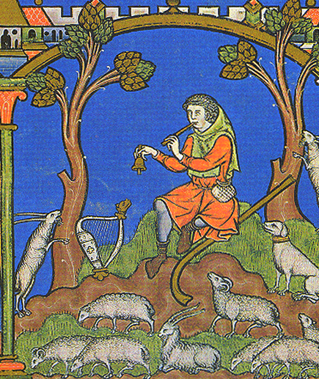
Beyond Counting Sheep
Roxanne Guildford
PhD candidate in Archaeology
University of Edinburgh
School of History, Classics and
Archaeology

Slide 2

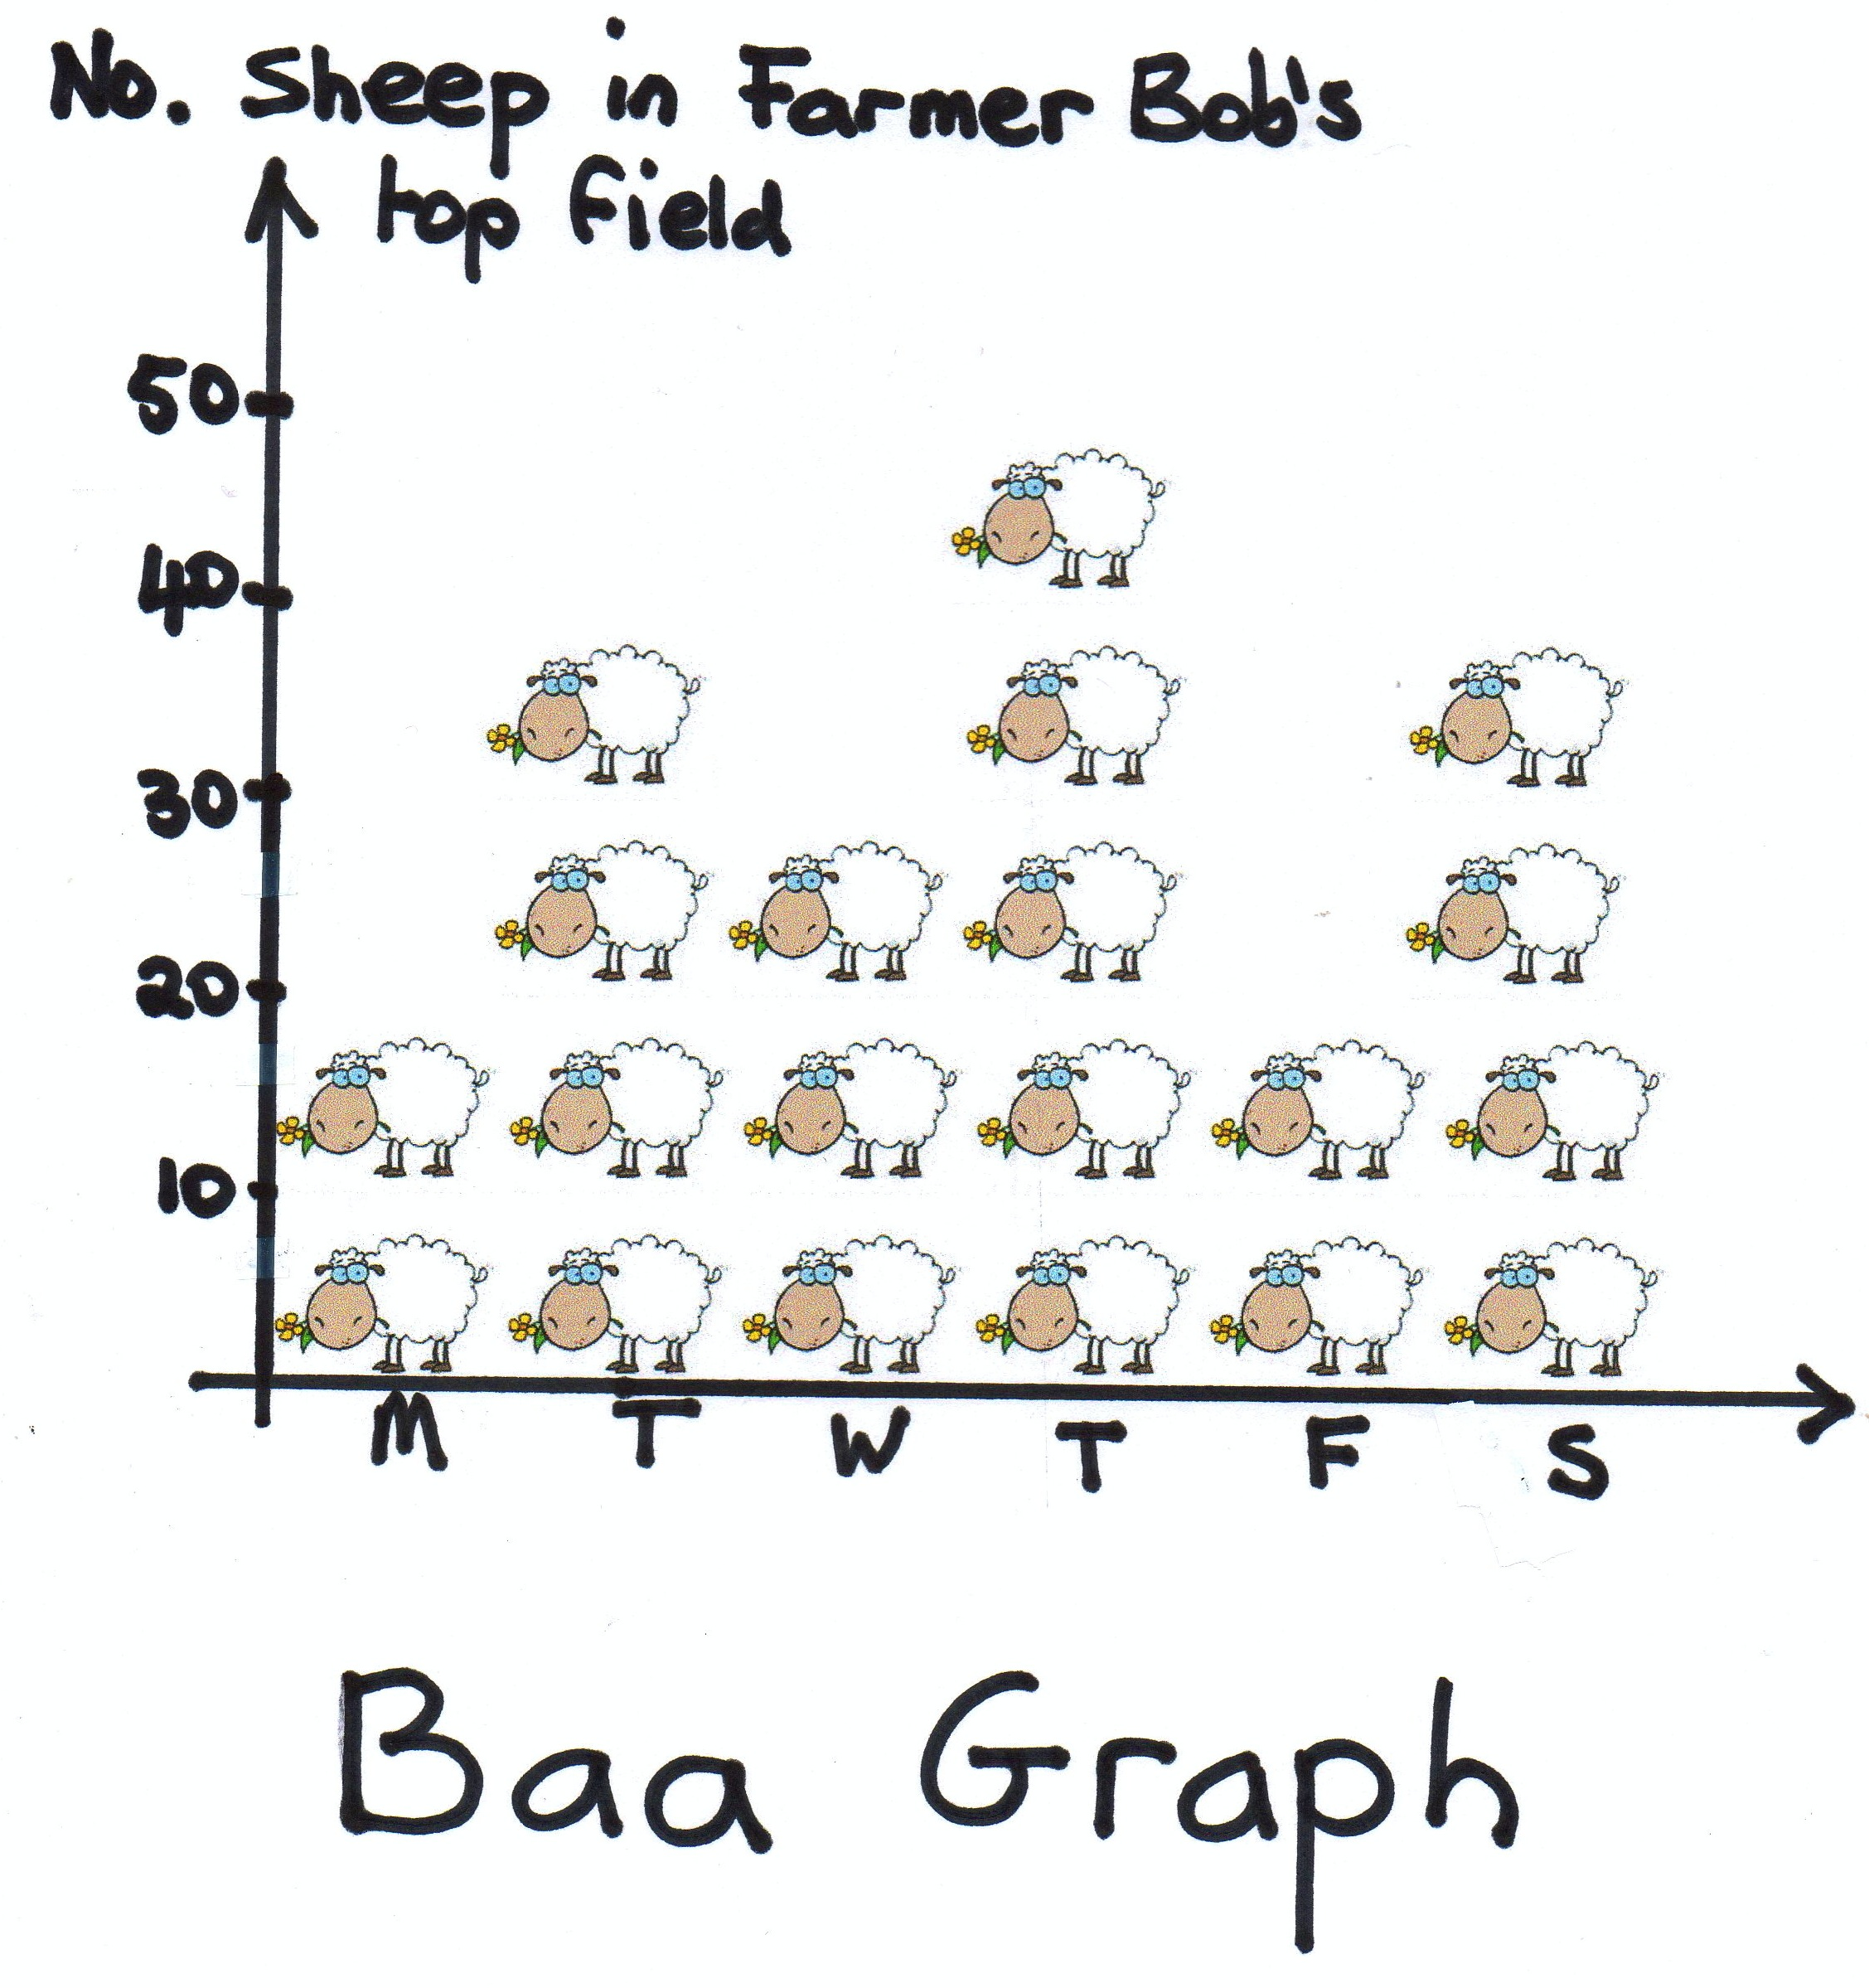
Why Count Sheep?
Exploring the relative ratio of sheep to other domesticated species in the archaeological record (aka taxonomic abundance) may show patterns in the data that help to explain:
Cultural and economic shifts in land management
Evidence of physical alteration of living domesticates
Change in pastoral husbandry strategies across time
Change in relationships between flock, farmer, and economic values

Slide 3
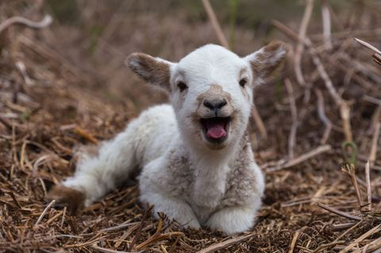
Why Count Sheep?
Exploring the relative ratio of sheep to other domesticated species in the archaeological record (aka taxonomic abundance) may show patterns in the data that help to explain:
Cultural and economic shifts in land management
Evidence of physical alteration of living domesticates
Change in relationships between flock, farmer, and economic values
Change in pastoral husbandry strategies across time

Slide 4
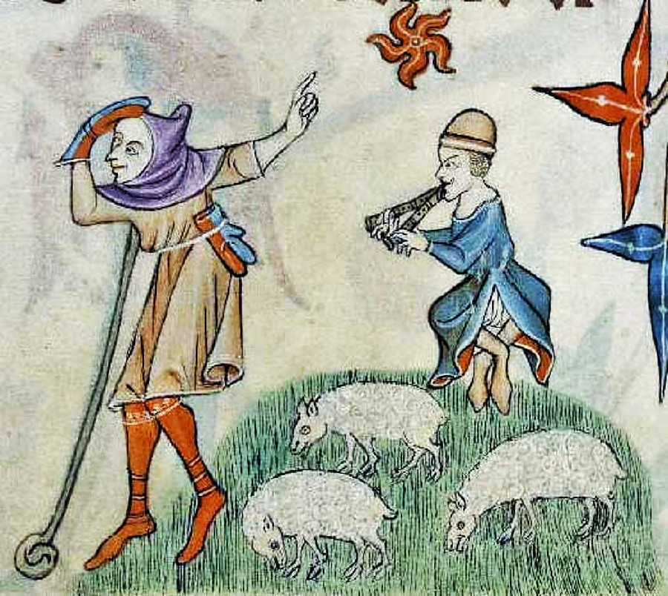

Slide 5

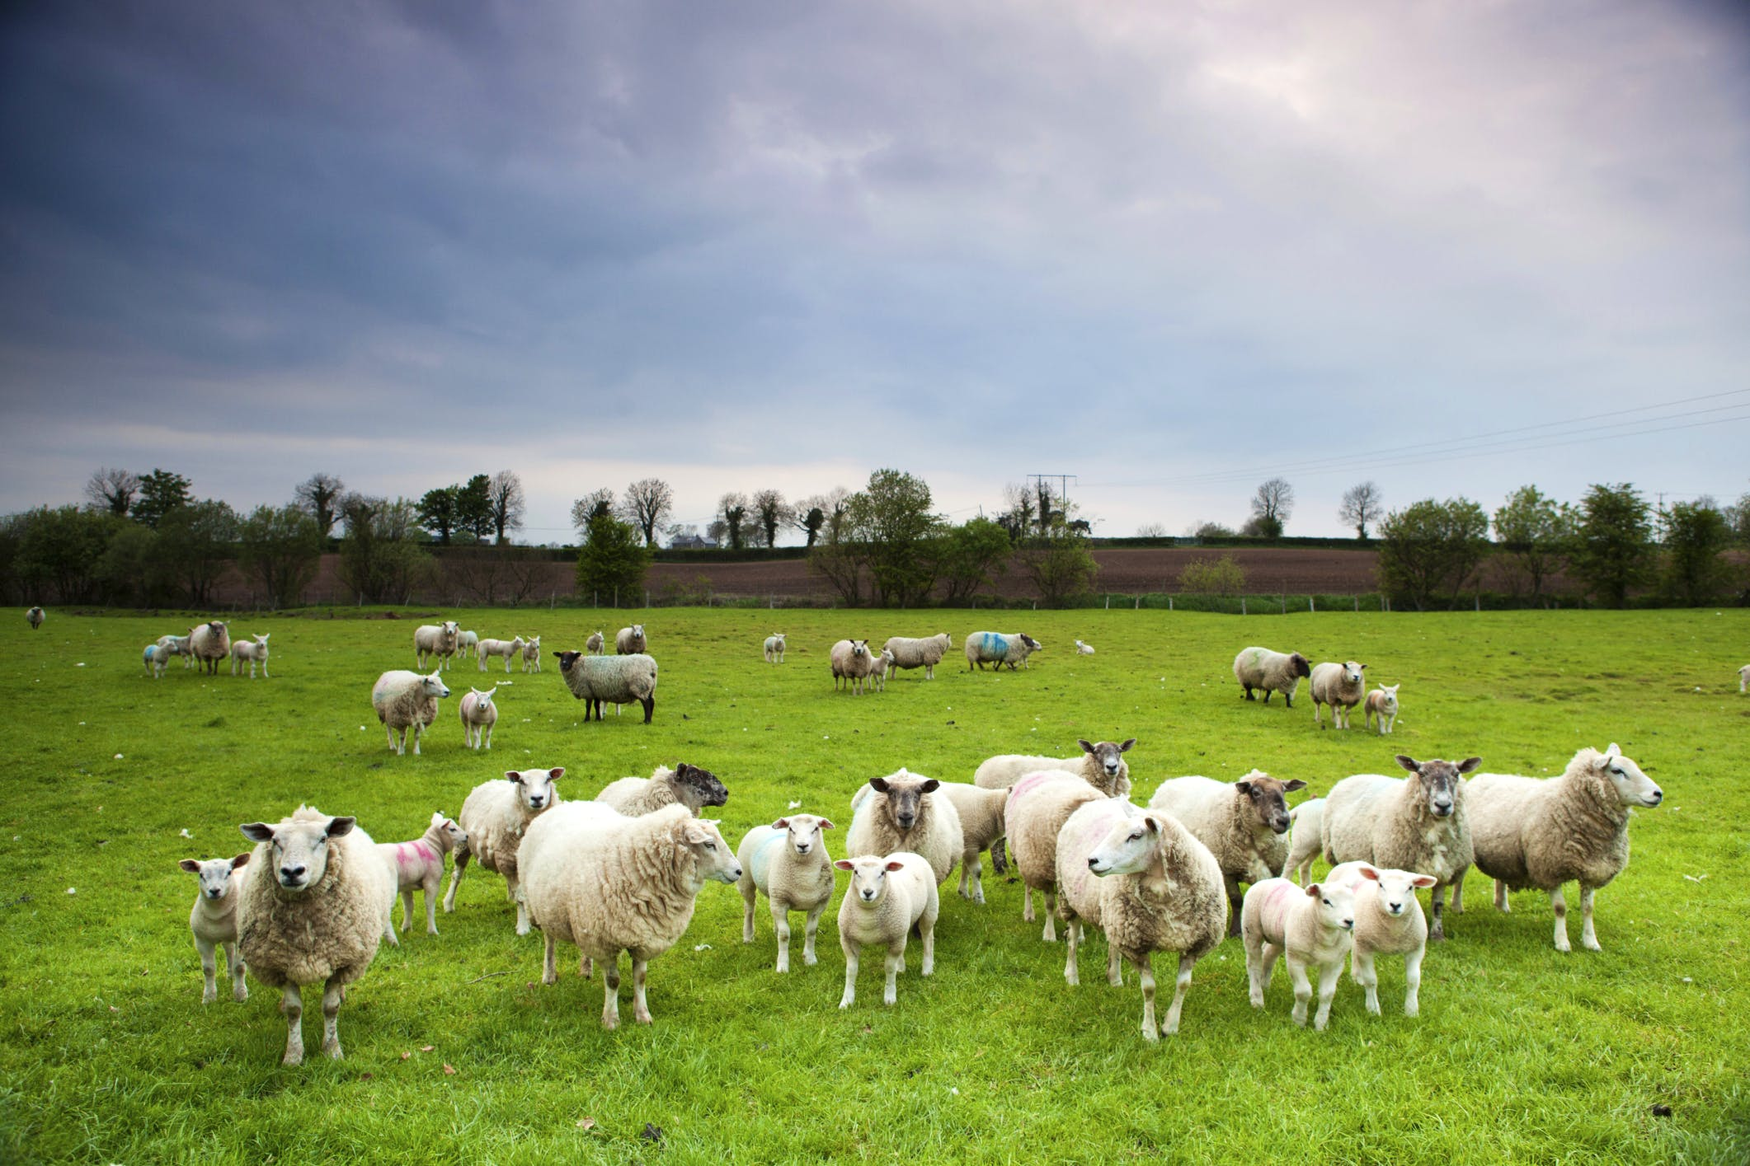

Slide 6
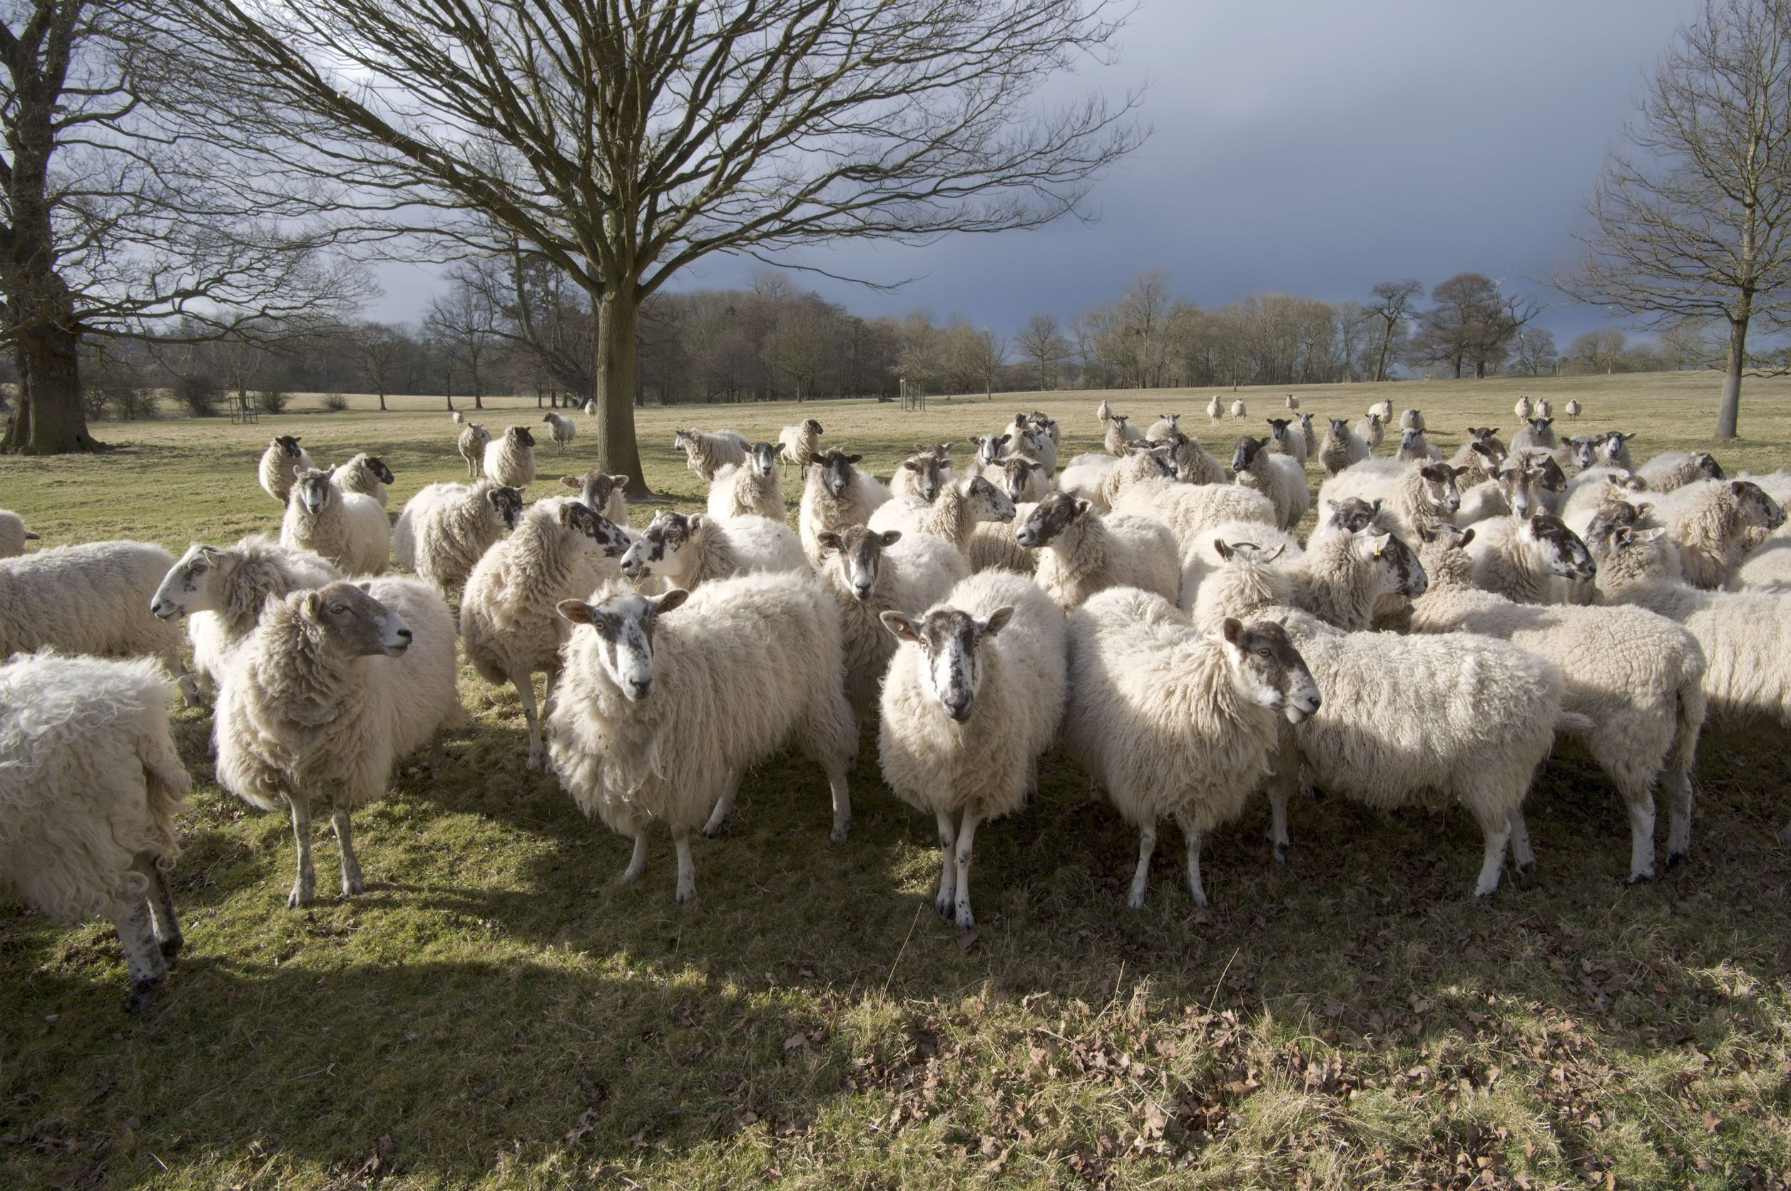

Slide 7
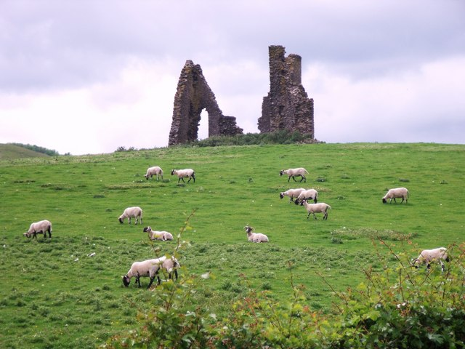

Slide 8
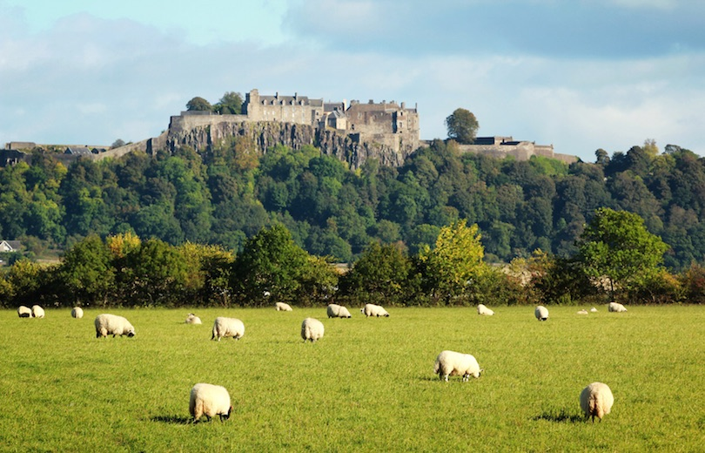

Slide 9
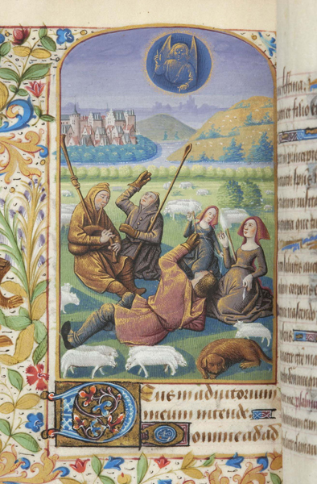
Changes in Medieval Pastoral Farming
Increased caring for sheep: greater investment = greater financial return
Change to cash-driven strategies: management of health influenced by marked demands rather than humanitarian concerns
Re-structuring of the human landscape: institution of sheepcotes, change in transhumance practice, movement from arable land to pasture, eventual enclosure and privatization of pastureland

Slide 10
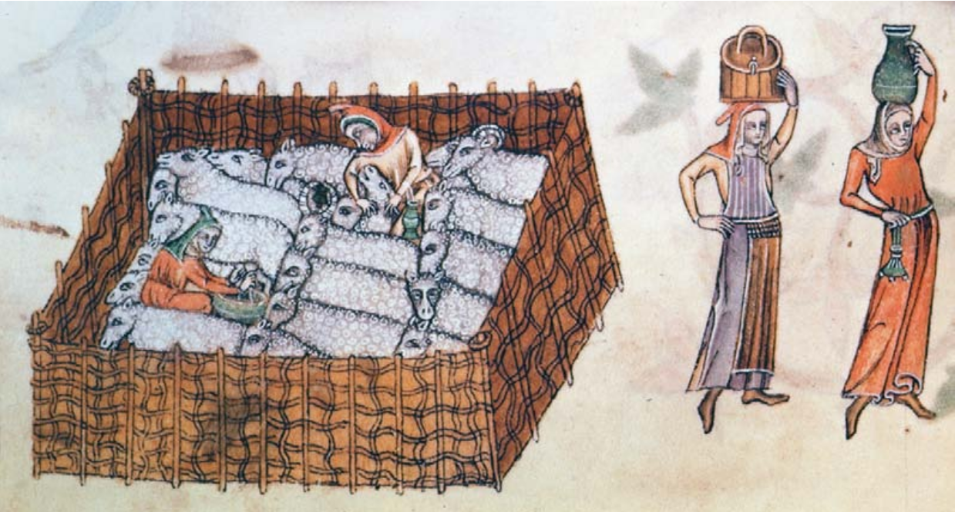

Slide 11
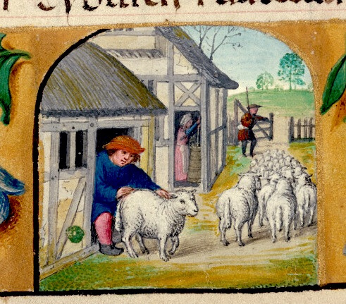
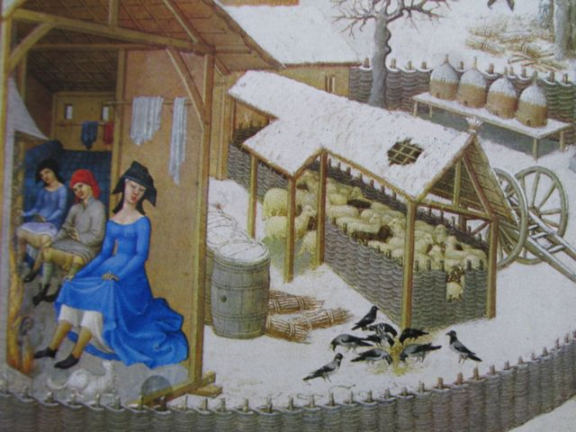

Slide 12
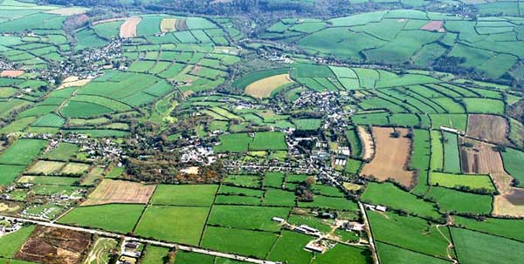

Slide 13
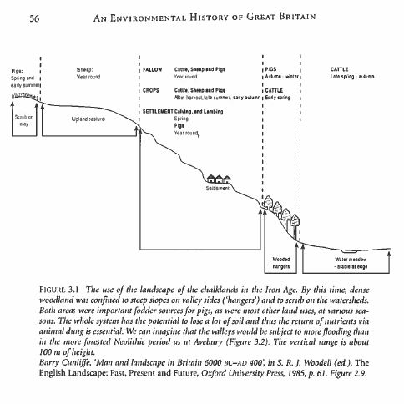
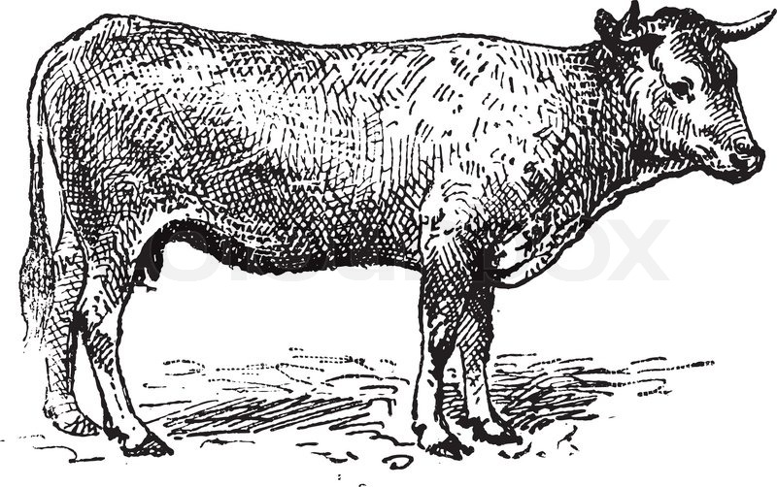
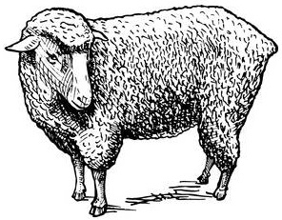
Beginning of intensive use of marginal landscapes for pastoral farming = separation of species over different elevations and differing ecological regions

Slide 14
Beginning of intensive use of marginal landscapes for pastoral farming = separation of species over different elevations and differing ecological regions
Movement of sheep to pastures that do not have sufficient water sources for cattle or arable farming; transhumance between upland elevations during summer months and sheltering near settlements during the winter (Martinmas to Easter)

Slide 15
Beginning of intensive use of marginal landscapes for pastoral farming = separation of species over different elevations and differing ecological regions
Movement of sheep to pastures that do not have sufficient water sources for cattle or arable farming; transhumance between upland elevations during summer months and sheltering near settlements during the winter (Martinmas to Easter)
Dominance of sheep across ecological landscapes: transition of arable lands to pasture, chalkland flocks, continued reduction of forests, limited boundaries by enclosure

Slide 16
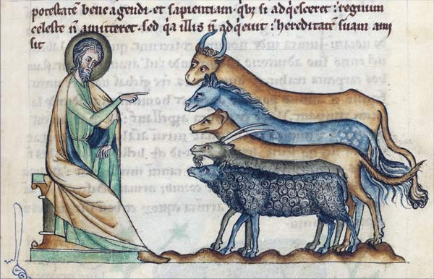
Challenges in Medieval Archaeology and the Faunal Record

Slide 17
ZOOARCHAEOLOGY
The study of animal remains associated with past human activity in the archaeological context:
Identification and analysis of faunal species
Reconstructing human diets
Determining the impact of animals on past economies
Understanding the environment at the time of deposition
Number of Identified Specimens (NISP):
The raw count of each bone and fragment; the base quantified unit of archaeological assemblages.
Tallied in whole numbers.
Relative Abundance Index (AI):
Measurement of taxonomic abundance, calculated
Σspecies1 / Σall species, as a ratio between 0.00 to 1.00

Slide 18
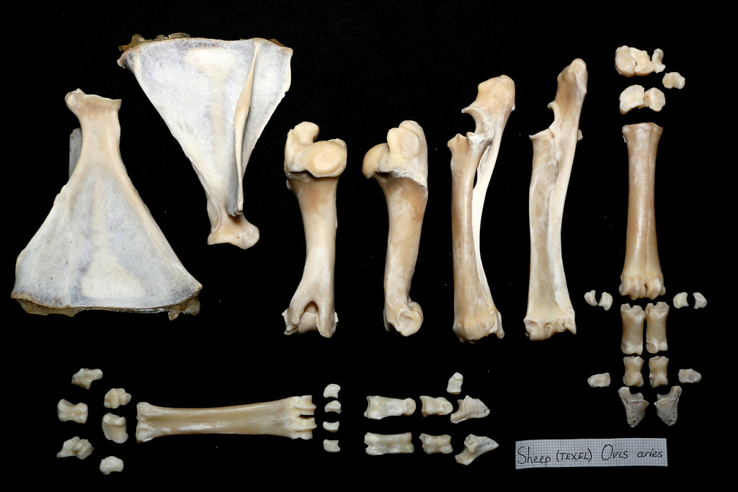
ZOOARCHAEOLOGY

Slide 19
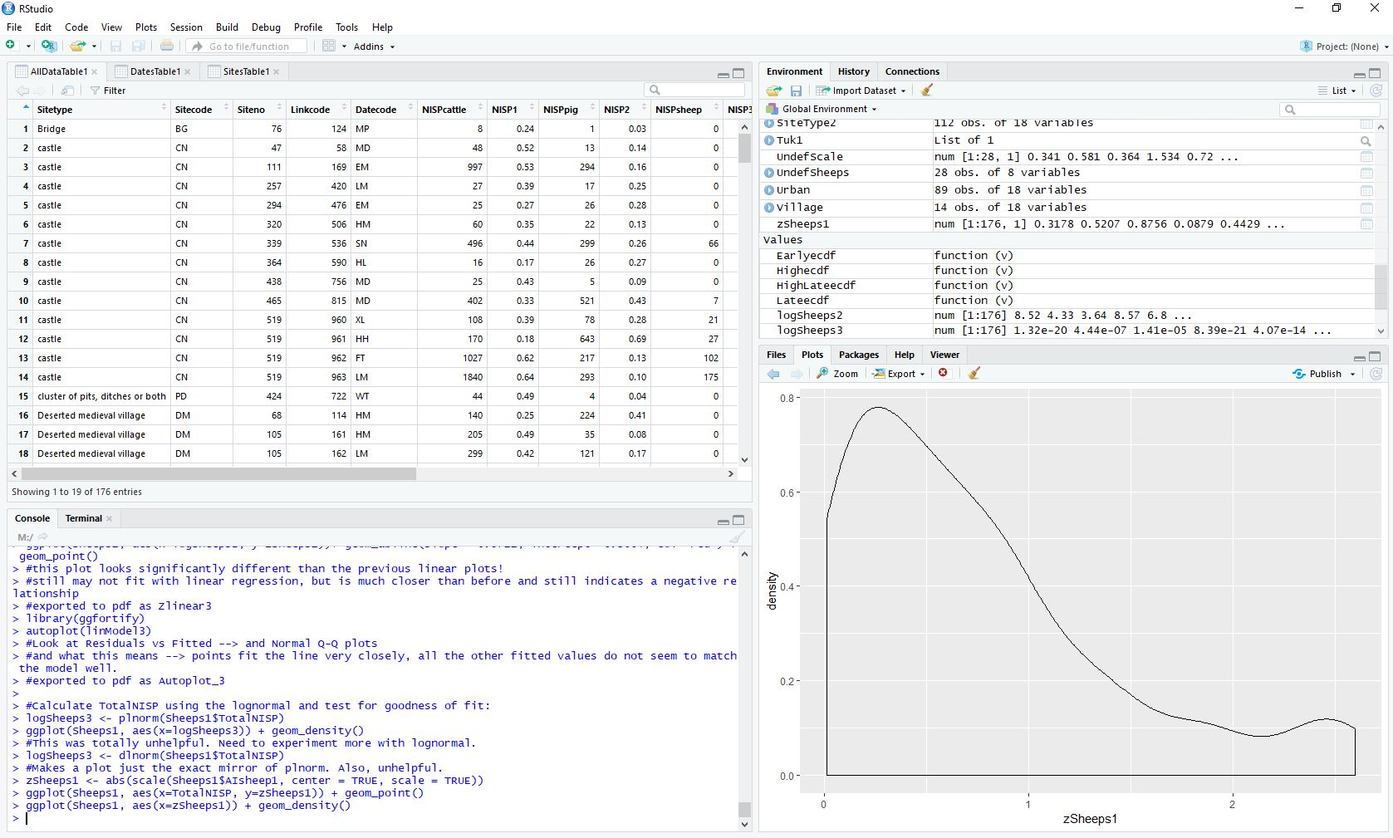
ZOOARCHAEOLOGY

Slide 20
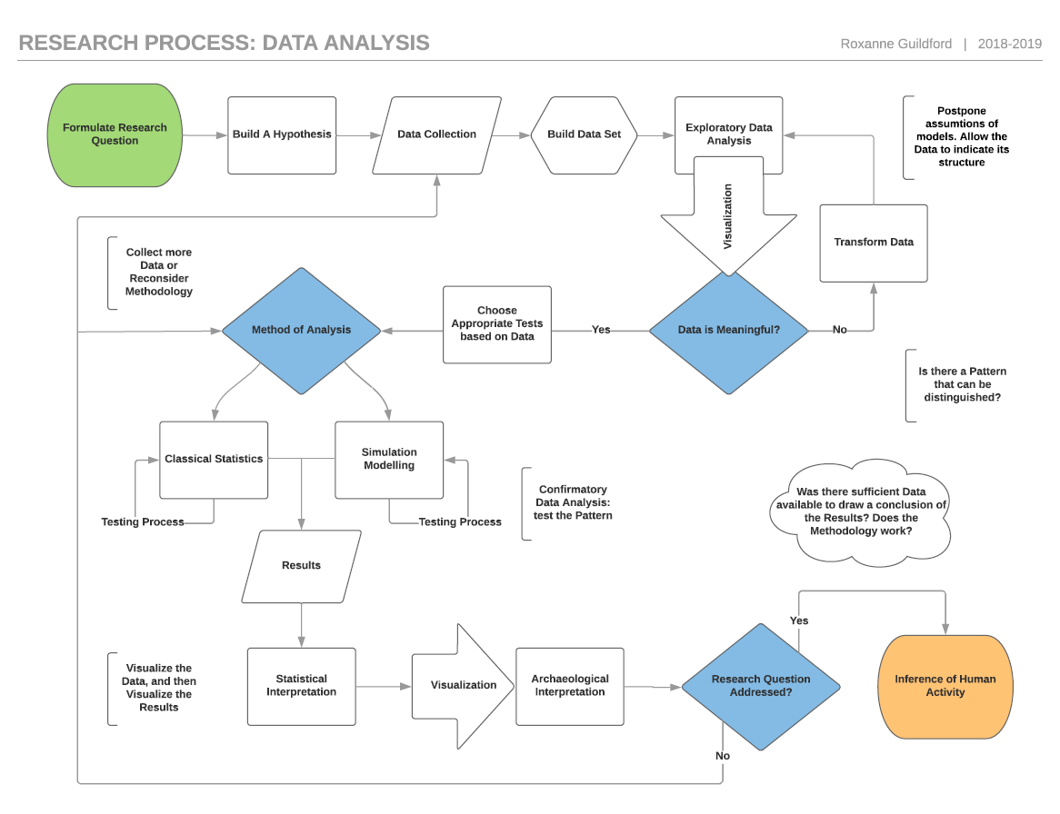

Slide 21
Data Analysis Process
Exploratory Data Analysis
Relationship Modelling
Hypothesis Testing

Slide 22
Measuring Variation in Faunal Assemblages
A Review of Animal Bone Evidence from Central England
Umberto Albarella, Tessa Pirnie, 2008
Geographic region of Central England
Published assessment reports and grey literature + unpublished manuscripts
No lower limit on minimum Assemblage size
Current data set presented here
No written report published
A Review of Animal Bone Evidence from the Saxon to Post Medieval Periods in Southern Britain
Matilda Holmes, 2018
Geographic region of South England
Published excavation reports, some unpublished manuscripts
Assemblage size limit > 100 NISP identified to major domesticates
Report in publication

Slide 23
Measuring Variation in Faunal Assemblages
Wharram Percy Archive
Stuart Wrathmell, 2012
Geographic region of North East England, North Yorkshire
13 published monographs, site reports + unpublished digital data
Primary and secondary data
Multiple sites and assemblages
Significant archaeological research over 50+
Bishopric of Winchester,
Winchester Pipe Rolls
Geographic region of South England, Hampshire
Medieval manorial accounts + published and archived archaeological reports
Multiple sites across a vast estate
Further research into individual assemblages required

Slide 24
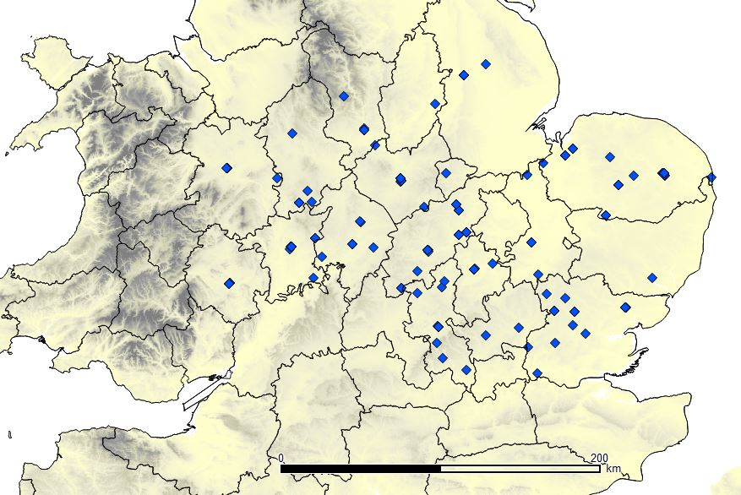
Albarella & Pirnie, 2008

Slide 25
Albarella & Pirnie, 2008
Individual Assemblages and Site Type
Number of Assemblages by Date Type

Slide 26
Exploratory Data Analsyis
Data Plotting in RStudio
Calculation of relative abundance index per assemblage (observation):
AIsheep1 = ΣNISPsheep / ΣNISPsheep + ΣNISPcattle
Data subset into Periods based on generally-recognized date parameters of Early, High, and Late Medieval Date Types:
Early Middle Ages (600–1066)
High Middle Ages (1066–1272)
Late Middle Ages (1272–1485)
With transition Periods for assemblages that fall across two established Date Types
Undefined (ubiquitous) Period for assemblages that fall under general “medieval” Date Types
Methodological issues inherent with time averaging large, complex, aggregated data sets

Slide 27
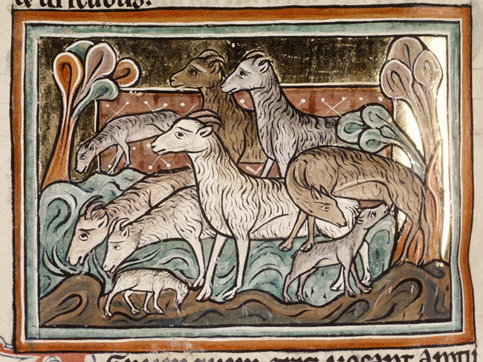
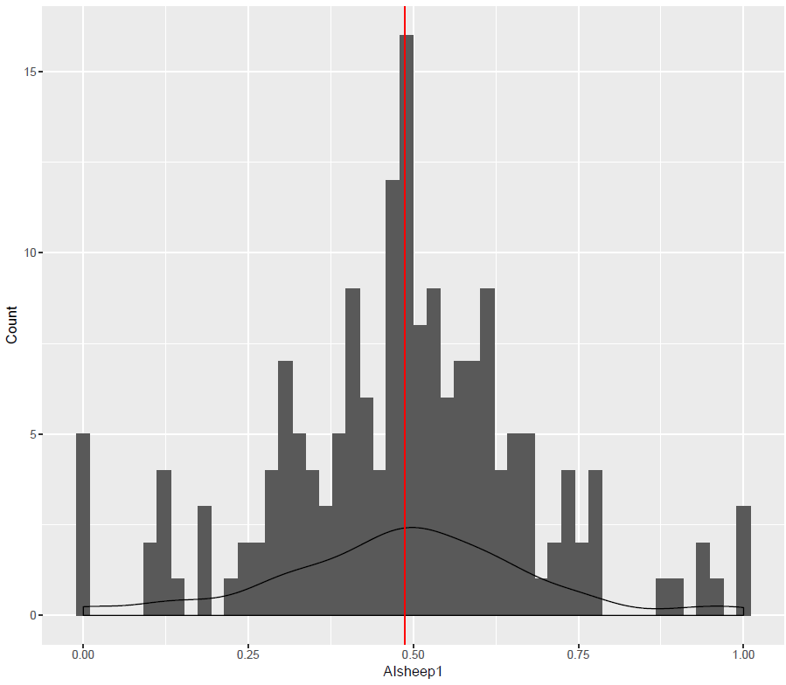
Density of entire data set appears somewhat normally distributed
Presence of possible outliers at opposite ends of the range
NISPsheep = 1.00
NISPcattle = 0.00
Most sites fall between 0.25 and 0.75 index
Mean calculated at 0.4873
Variance = 0.0389
Standard deviation = 0.1972

Slide 28
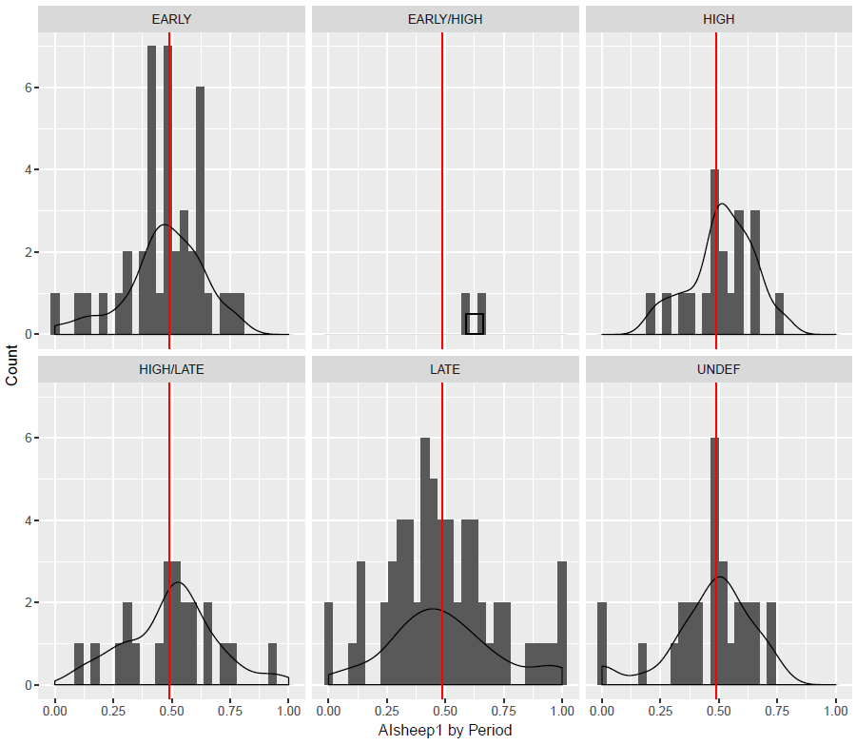
Very different picture of distribution as separated by Period
Late Period is not normally distributed:
Central peak is further away from the mean
Clumping of values at or near
1.00 and 0.00
Lean towards dominance in cattle ratio with greater number of sites with only cattle or sheep remains
Early-High and Undefined not useful for statistical analysis, subsequently removed from the study

Slide 29
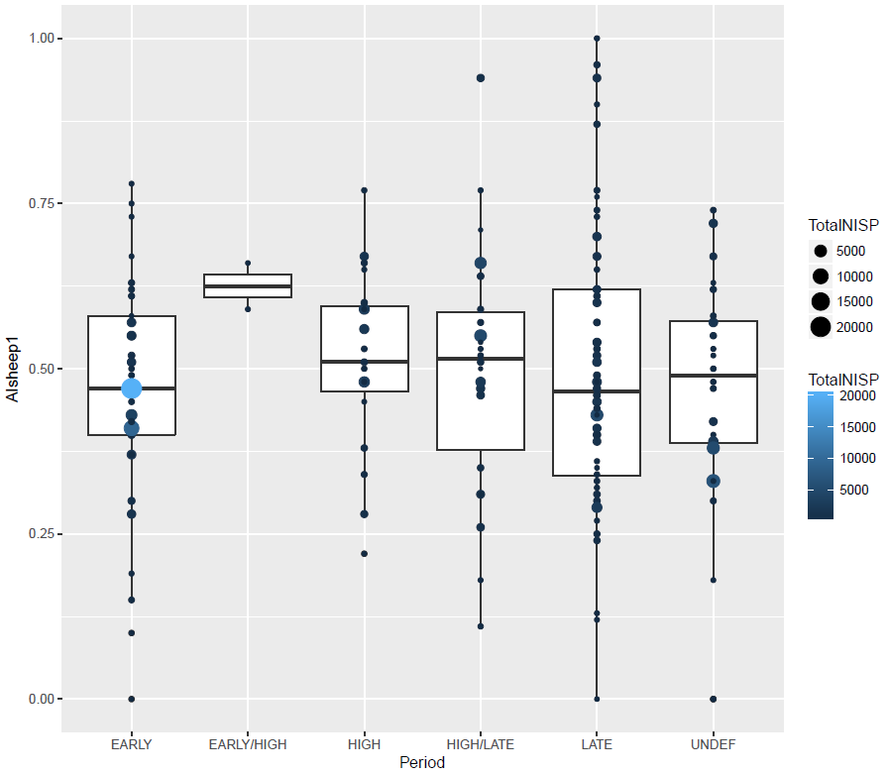
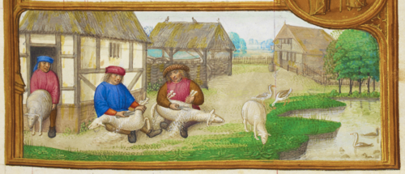
Differences in the spread of the data and the range are apparent
Late Period stands out again as showing a more even distribution of data across the entire range
Early Period stands out as the largest assemblages are present, and clumped around the median

Slide 30
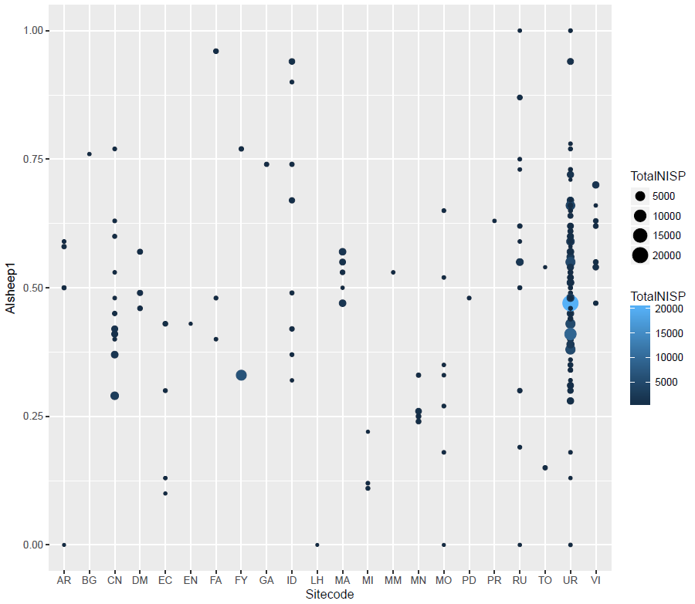
Differences in the spread of the data and the range are apparent
Late Period stands out again as showing a more even distribution of data across the entire range
Early Period stands out as the largest assemblages are present, and clumped around the median
Largest assemblages are from Urban sites

Slide 31
Differences in the spread of the data and the range are apparent
Late Period stands out again as showing a more even distribution of data across the entire range
Early Period stands out as the largest assemblages are present, and clumped around the median
Largest assemblages are from Urban sites, as well as the largest number of observations

Slide 32
Hypothesis Testing
Statistical Calculations in RStudio
t.test(EarlySheeps$AIsheep1, LateSheeps$AIsheep1): p-value = 0.08775
means1 <- round(tapply(Sheeps1$AIsheep1, Sheeps1$Period, mean), digits=2)
# EARLY EARLY/HIGH HIGH HIGH/LATE LATE UNDEF
# 0.53 0.38 0.49 0.50 0.49 0.54

Slide 33
Hypothesis Testing
Statistical Calculations in RStudio
t.test(EarlySheeps$AIsheep1, LateSheeps$AIsheep1): p-value = 0.08775
means1 <- round(tapply(Sheeps1$AIsheep1, Sheeps1$Period, mean), digits=2)
# EARLY EARLY/HIGH HIGH HIGH/LATE LATE UNDEF
# 0.53 0.38 0.49 0.50 0.49 0.54
anovaResult <- aov(Sheeps1$AIsheep1 ~ Sheeps1$Period): p-value = 0.739
Tuk1 <- TukeyHSD(aov_Sheeps1): no significant values

Slide 34
Hypothesis Testing
Statistical Calculations in RStudio
t.test(EarlySheeps$AIsheep1, LateSheeps$AIsheep1): p-value = 0.08775
means1 <- round(tapply(Sheeps1$AIsheep1, Sheeps1$Period, mean), digits=2)
# EARLY EARLY/HIGH HIGH HIGH/LATE LATE UNDEF
# 0.53 0.38 0.49 0.50 0.49 0.54
anovaResult <- aov(Sheeps1$AIsheep1 ~ Sheeps1$Period): p-value = 0.739
Tuk1 <- TukeyHSD(aov_Sheeps1): no significant values
var.test(EarlySheeps$AIsheep1, LateSheeps$AIsheep1): p-value = 0.02301
# The p-scores here indicate that only two tests reject the null hypothesis (variance is statistically equal):
#Early to Late Period p-value = 0.02301
#High to Late Period p-value = 0.01405

Slide 35
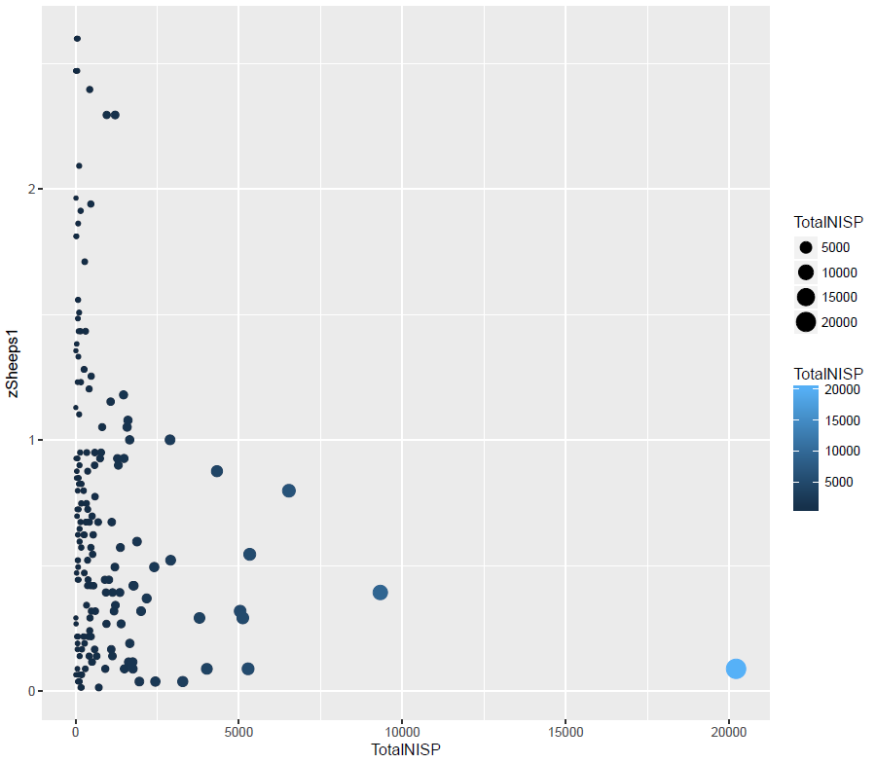
Relationship between NISP and Z-score
Correlation of z-scores and TotalNISP:
cor(zSheeps1, Sheeps1$TotalNISP): -0.2007795
linModel3 <- lm(logSheeps1 ~ TotalNISP, data=Sheeps1): p-value: 1.49e-07

Slide 36
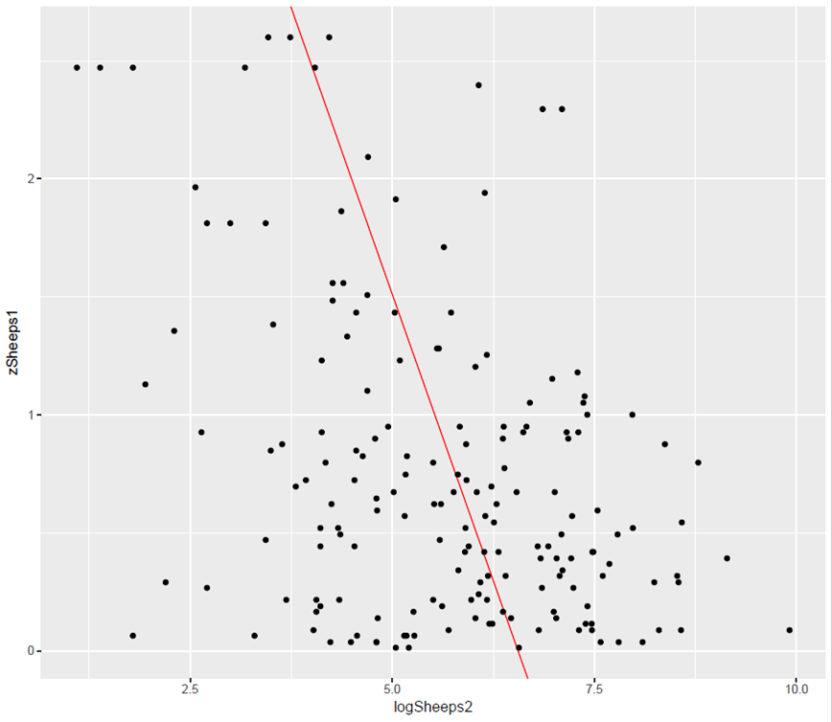
Relationship between NISP and Z-score
Correlation of z-scores and TotalNISP:
cor(zSheeps1, Sheeps1$TotalNISP): -0.2007795
linModel3 <- lm(logSheeps1 ~ TotalNISP, data=Sheeps1): p-value: 1.49e-07
#Adjusted R-squared: 0.1422
Data indicates there is a relationship between NISP and Z-score, but it is not a linear relationship, and only explains a small proportion of the variation seen here

Slide 37
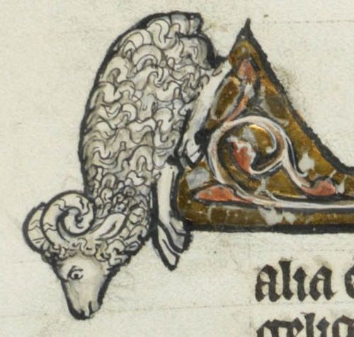
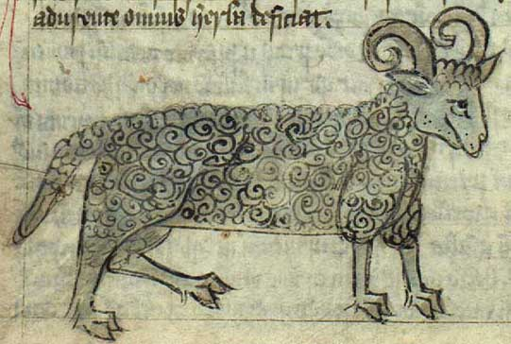
Next Steps
Further test correlations of NISP and Z-score: explore multivariate analysis methods and investigate relationship between the variance of the mean and NISP between Periods
Explore the effect of environmental factors on species relative abundance
Investigate statistical significance of differences in species abundance between Central and Southern England
Continue data collection and start reviewing individual case studies of rural settlements to explore intra-site variation across excavations over time
Continued work on re-evaluation of established methodology as well as integration with outside data sets
Ensure accessibility of data and reproducibility of results, establish publications on case studies

Slide 38
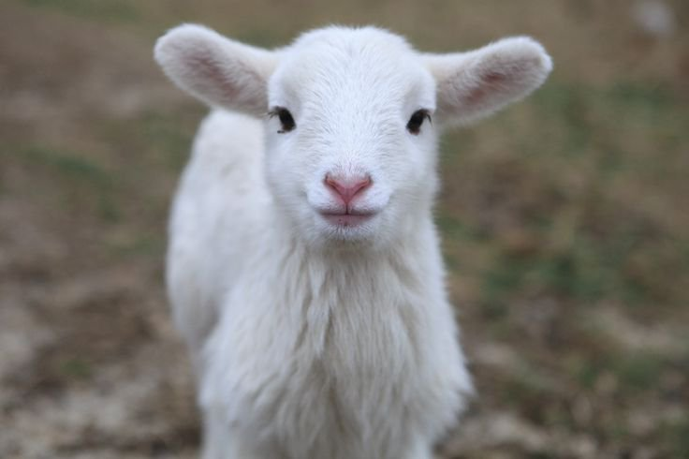
Thank You!

Slide 39
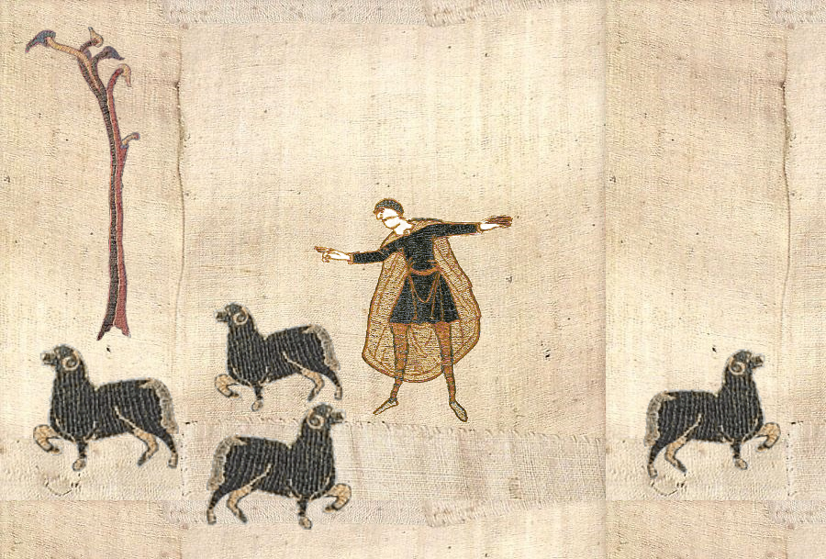
Roxanne Guildford
roxanne.guildford@ed.ac.uk
https://github.com/rguildford

